Slide 1
How do Presidents Speak
Text analysis on State of the Union Addresses since 1961

Slide 2
Agenda
Research question
Data source
Methods
Results
Forward

Slide 3
Research question
Question: To what extent are presidential speeches affected by the macroeconomic situation of the United States?
Motivation
Economic voting: The discipline of political science has shown a clear relationship between economics and voting behavior
Nobody has really tried to understand how the economic situation affects the content and form of political speeches
Can we also talk about Economic Speaking?
Notes:
Bjørn

Slide 4
Three Hypotheses
Major American political speeches use more positive words when the US economy is on an upward going trend.
The language used in major American political speeches has become more simple over time
Major American political speeches have become more egocentric over time

Slide 5
Data sources and collection
Data: American State of the Union Addresses since 1961
Written addresses excluded because they probably differ significantly from oral addresses
We exclude addresses from before 1961 because they are mostly written and the world bank only has historical GDP rates from 1961 and onward
Scraping: Addresses collected from the American Presidency Project
We built two scraper functions (using BeautifulSoup)
Link-collector: Collects links to all websites with State of the Union Addresses
Text-collector: Collects the following information 1) Year 2) President 3) Date 4) Text
Notes:
Alleanna

Slide 6
Preliminary results

Slide 7
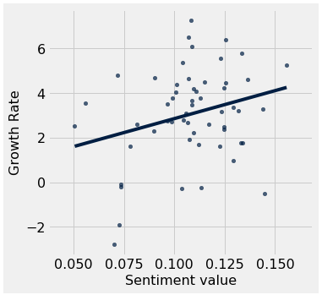
Result 1:
We found a weak positive association between growth rate and sentiment values, so high growth rates are associated with positive speeches.
Correlation coefficient (r value) of 0.27
Method:
Sentiment analysis using Text Blob
Measure: Average sentiment value for all the sentences in the speech. +1 is equal to perfectly positive speech and -1 is equal to perfectly negative speech.
Critique:
Textblob is a rather imprecise method for sentiment analysis

Slide 8
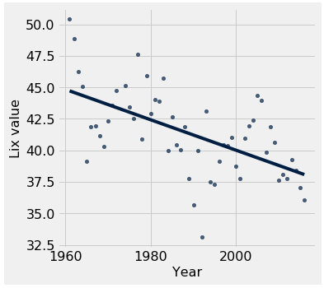
Result 2:
We found that since 1961 the language used the Addresses have become more simple
Correlation coefficient (r value) of -0.583
Method:
Language simplicity measured using the LIX function
LIX= (A/B)+(100C)/A where A= Number of Words, B= Number of Sentences, and C= Number of words over 6 letters.
Critique:
Does LIX really measure complexity? (word length vs. word combinations)

Slide 9
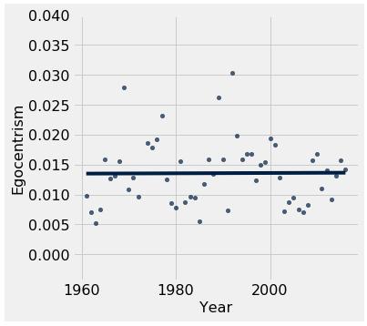
Result 3:
No association between time and usage of egocentric words in the Addresses
Correlation coefficient (r value) of 0.008
Method:
Word frequency
The normalized proportion of egocentric words ( “I”, “me”, “my”, “myself”)
Critique:
Does not take the context into account

Slide 10
Forward
What do we need?
Regression: Which words are associated with high growth?
Spacy: Do we see any changes in the proportion of different word types? Adjectives, Nouns etc. ?
What is the broader implications?

